Slide 1
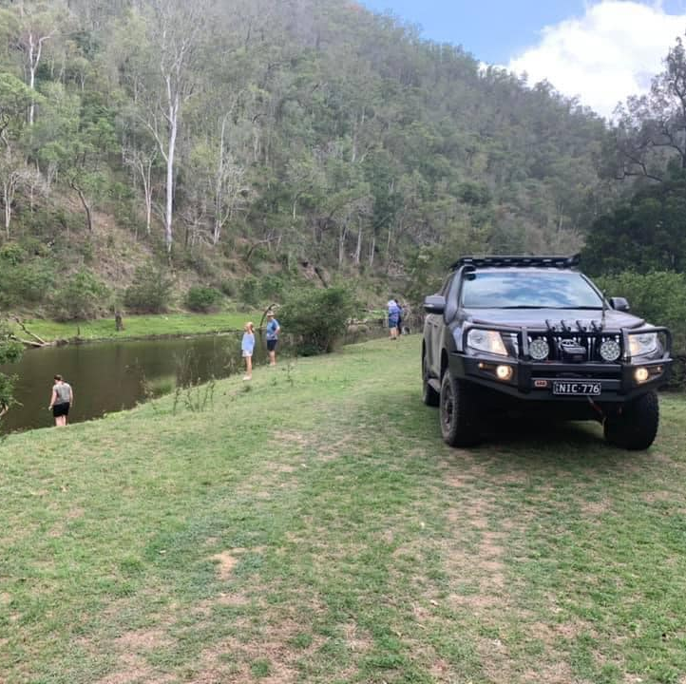
Borumba Dam and Landcruiser Mt Park
When: Friday 29th October – Sunday 30th October 2021
Where: Borumba Dam and Landcruiser Mt Park
Trip grade: Medium (AT Tyres and lift preferred)
Vehicle Limit: 10 Cars but reserves will be taken.
Please book on the TLCC Club website – Max 10 cars
Trip Leader: Nick Miller

Slide 2
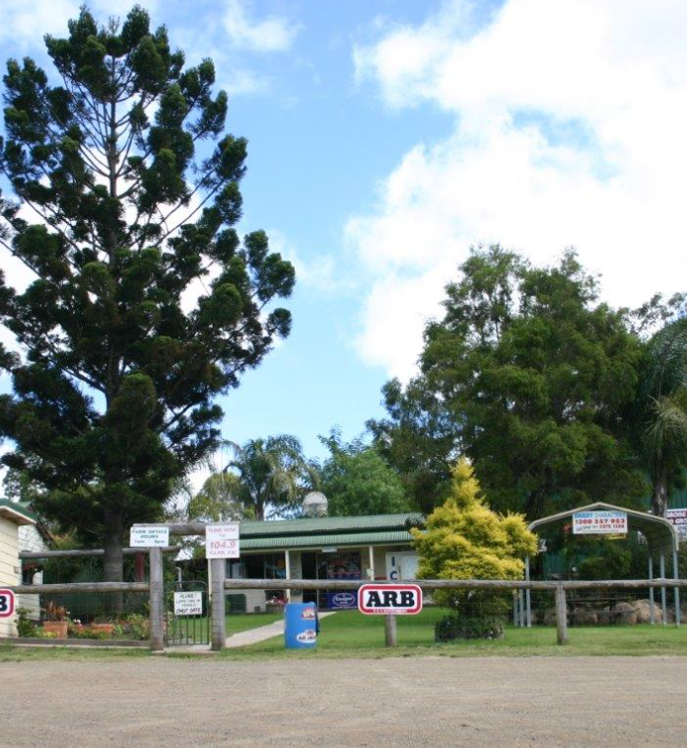
What’s there to do?
2 hours drive from Brisbane.
Medium driving through National Parks and HQ Plantations and State Forest.
Option to do a couple of steeper difficult hills at Landcruiser Park or near Jimna.
Tracks through pine plantations, open country and dense rainforest
Please be prepared for possible scratches on cars from some lantana
Low range steep climbs on loose soil and clay at times
Chance to drive a privately leased farming area with scenic views of Borumba Dam
Landcruiser Mountain Park – 4WD Park.
See Landcruiser Mountain Park Jimna - Landcruiser Mountain Park Jimna
Swimming at the Yabba Creek/Borumba Dam at the campsite – Bring swimmers if we have time and there is sufficient water

Slide 3
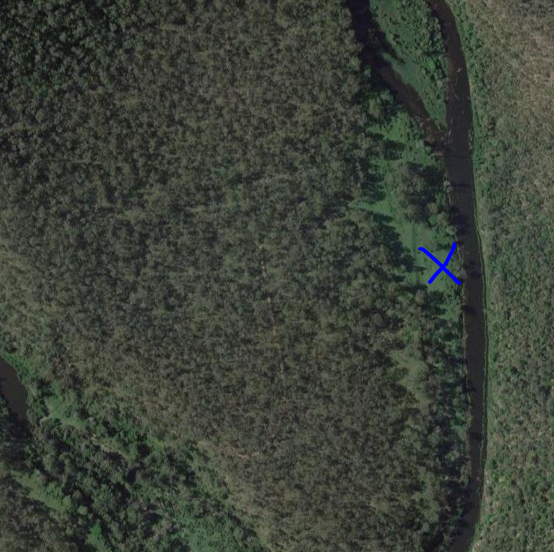
Camping
Camping on a privately leased farm. Club has visited the site before but never camped there.
Rodney Garrett farms the area.
He asks that members make a donation to his local football club in the area.
Donation fee and payment method to be advised.
We must not bring dogs and or weapons onto the property and we must respect the tracks and livestock.
No showers.
Fire permitted if there is no fire ban.
Firewood available to collect on the property but bring a chainsaw if you have one.

Slide 4
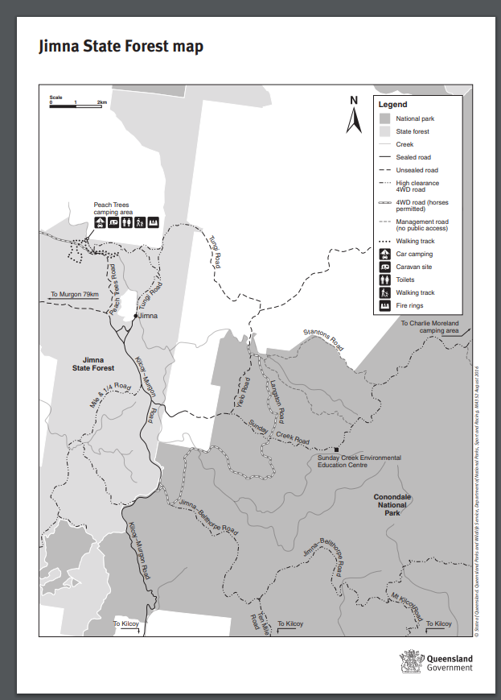
Maps
Google Maps location for Farm:
https://goo.gl/maps/LZVEiNSAFqt9R6PE6
https://parks.des.qld.gov.au/__data/assets/pdf_file/0027/158580/jimna-state-forest-map.pdf

Slide 5
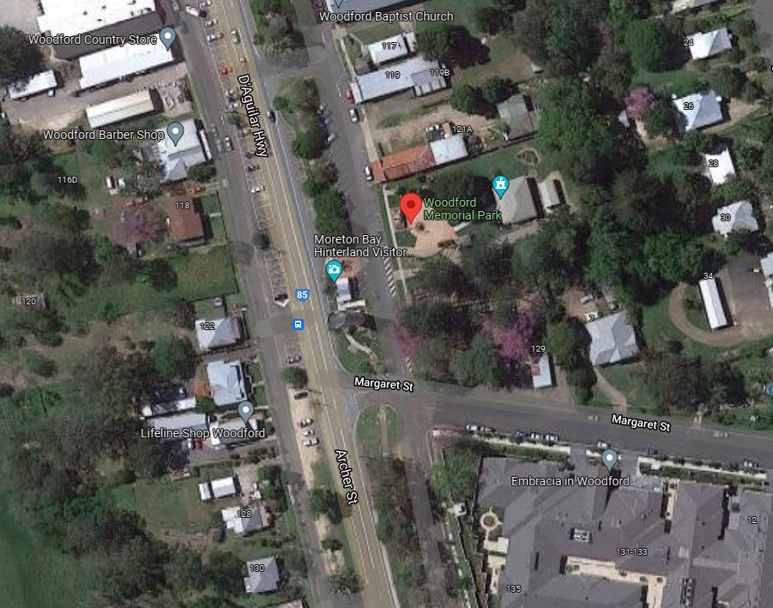
What to bring:
Bring food for the weekend
Bring camping gear, chairs etc
Bring recovery gear.
Bring Air compressor as we will air down.
No pets allowed in the National Park or Farm.
Camping only (off road camper trailers permitted if experienced).
Lollies for the gate keepers
Lots of Water
Swimmers, Towel and Sunscreen
Long pants to avoid being scratched by lantana and to protect from snakes
Fuel for the weekend (no fuel in Jimna)
Payment for Day use at Landcruiser Mt Park
Donation for camping (Payment method TBA)
Where to Meet:
Woodford Memorial Park
123 Archer St Woodford QLD 4514
9am.

Slide 6
Agenda:
Friday:
Meet at Woodford at 9am.
Drive to Mount Kilcoy and let our tyres down.
Drive up into Conondale National Park and up into Jimna.
Let tyres down to 22-24
Saturday:
Drive to Landcruiser Mt Park via Kingham Rd
9.30am Meet up with David Arnot TLCC Club Member
Drive some tracks across the Park.
3pm Depart for campsite.
4pm have a swim in the Borumba Dam/Yabba Creek
Sunday:
Pack up.
Drive up Borgan Road.
We will aim to do some more tracks around Jimna in the morning.
In the afternoon we will drive home to Kilcoy via Linville. Off-road/sturdy caravans and regular camper trailers can still be towed on this part of the trip as it’s a dirt road that follows a creek with some gates through properties. Aim to be back in Brisbane by around 6pm unless you wish to leave earlier.
Trip Leader:
Nick Miller 0422174013 nickgmiller@outlook.com

